Slide 1
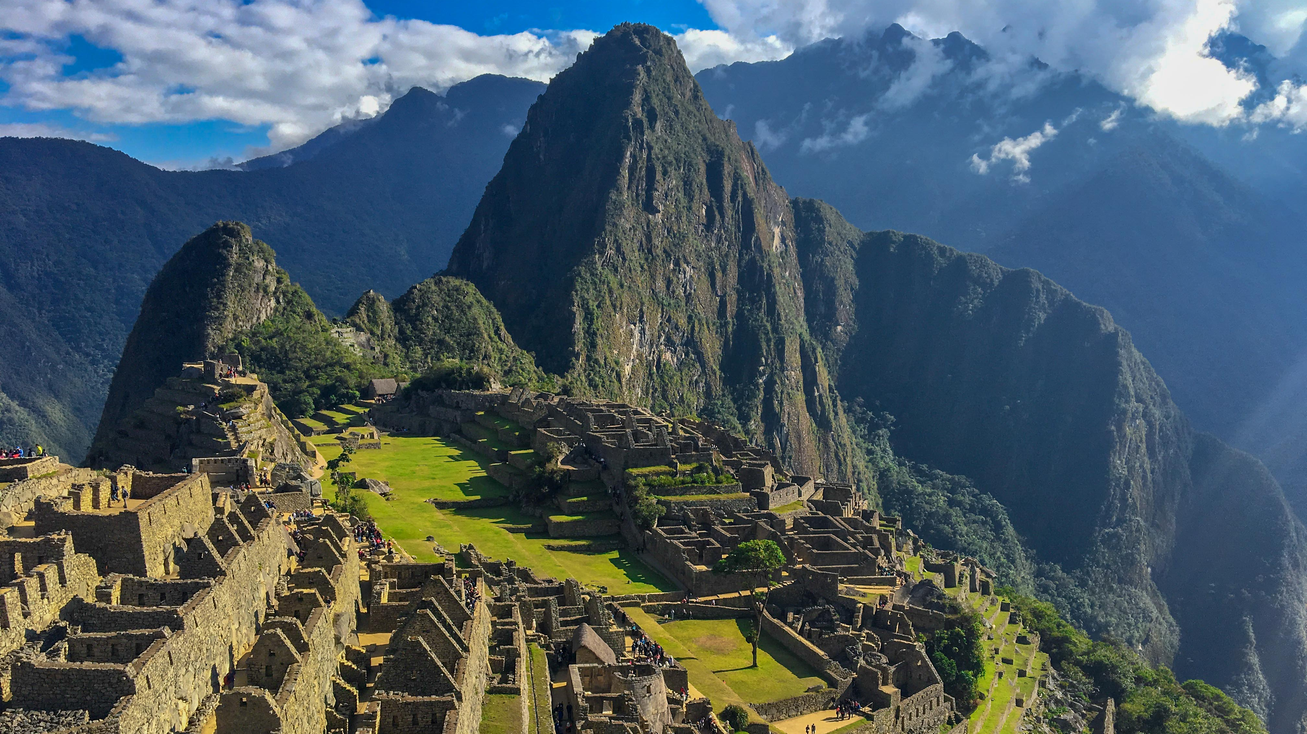


Henley In Arden School – Peru / Machu Picchu 2027
Come along to our Parents Presentation to find out more: (year 9 & 10 students)
Wednesday 15th October at 6pm in the Main Hall

